Slide 1
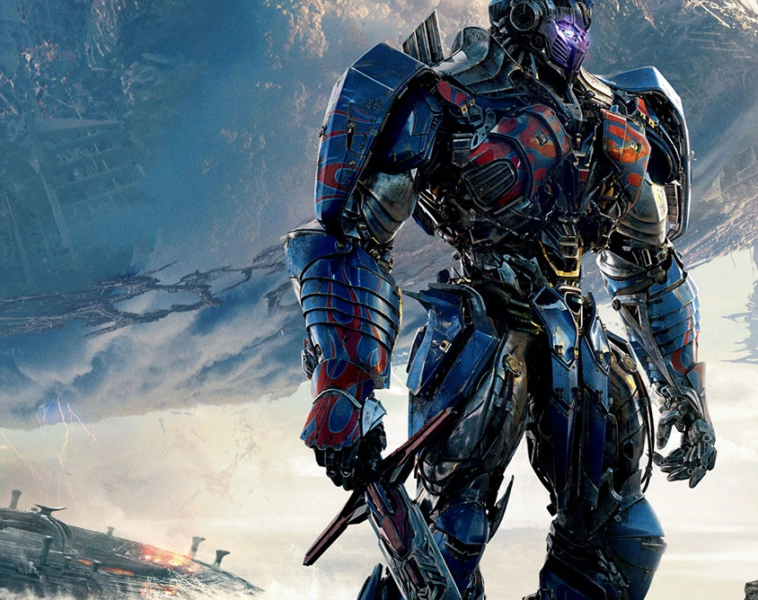
Transformers AI

Slide 2
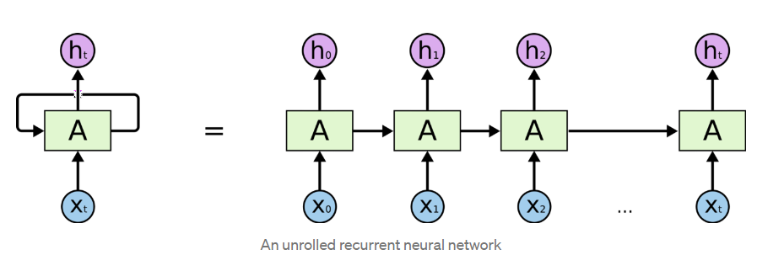
Recurrent Neural Networks (RNN)
RNNs are feed-forward neural networks that are rolled out over time. A RNN can be thought of as multiple copies of the same network, each network passing a message to a successor.

Slide 3
An RNN has two major disadvantages
Slow to train
Vanishing gradient

Slide 4
Long Short-Term Memory (LSTM)
Long short-term memory (LSTM) is a special kind of RNN, specially made for solving vanishing gradient problems. They are capable of learning long-term dependencies.
LSTMs can selectively remember or forget things that are important and not so important.

Slide 5
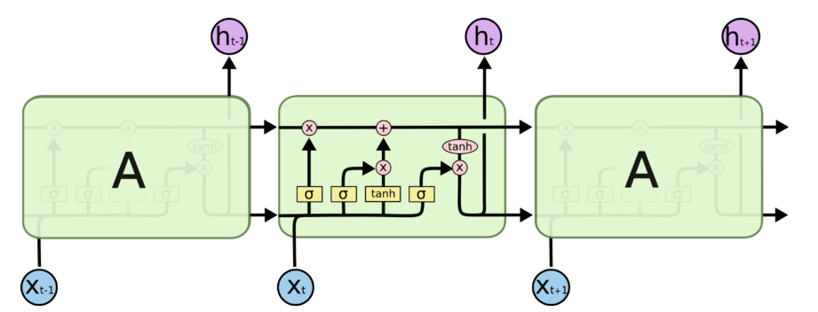
LSTM is even more slower to train as compared to RNN.
Vanishing gradient problem still persists.
Sequential computation inhibits parallelization.
Distance between positions is linear
Drawbacks of LSTM

Slide 6
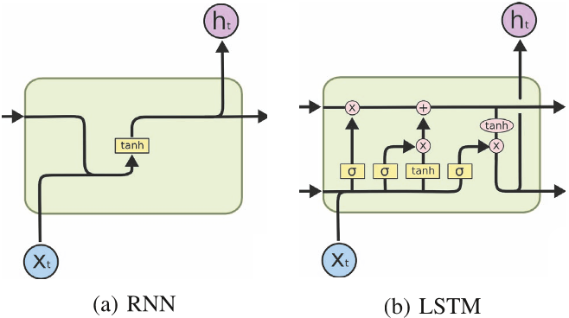
Simple RNN vs LSTM

Slide 7
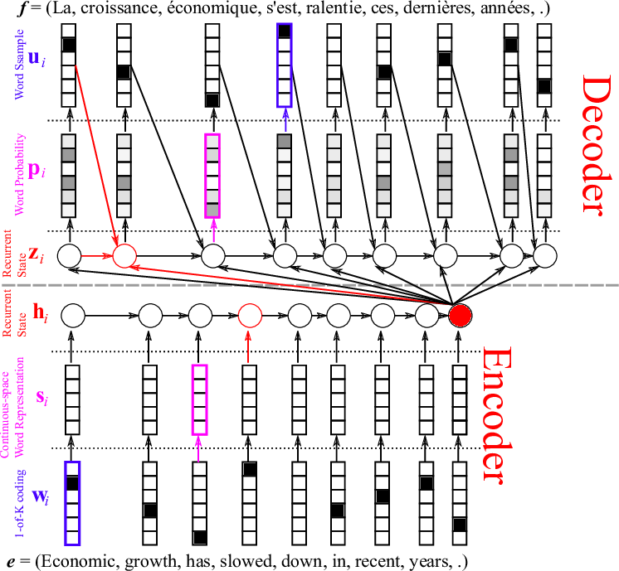
Encoder-Decoder machine translation

Slide 8
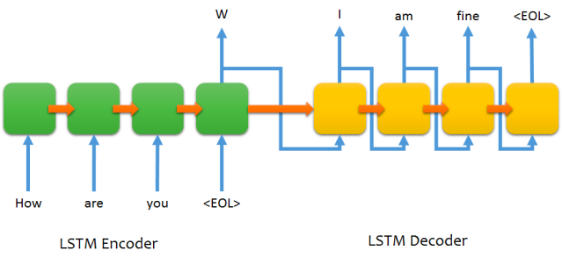
Encoder-Decoder LSTM structure for chatting

Slide 9
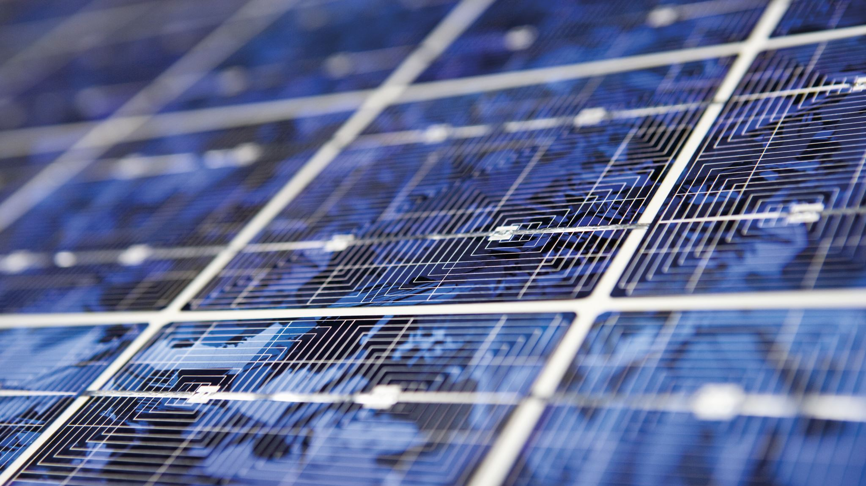
Attention
To solve some of these problems like vanishing gradient, researchers created a technique for paying attention to specific words.
Attention in neural networks is somewhat similar to what we find in humans. ‘It means they focus on certain parts of the inputs while the rest gets less emphasis’. Attention highly improved the quality of machine translation as it allows the model to focus on the relevant part of the input sequence as necessary.

Slide 10
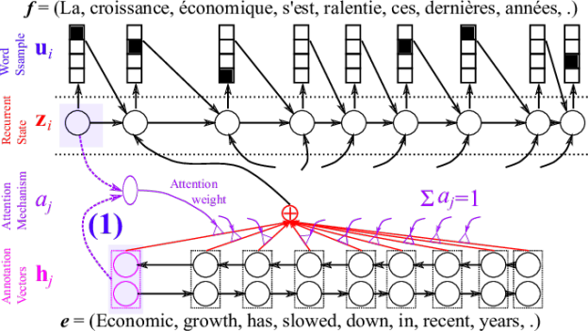
But some of the problems that we discussed, still are not solved with RNNs using attention. For example, processing inputs (words) in parallel is not possible. For a large corpus of text, this increases the time spent translating the text.

Slide 11
Convolutional Neural Networks (CNN)
Convolutional Neural Networks help solve these problems. With them we can-
Trivial to parallelize (per layer)
Exploits local dependencies
Distance between positions is logarithmic
2. Why Transformers?
The problem is that Convolutional Neural Networks do not necessarily help with the problem of figuring out the problem of dependencies when translating sentences. That’s why Transformers were created, they are a combination of both CNNs with attention.

Slide 12
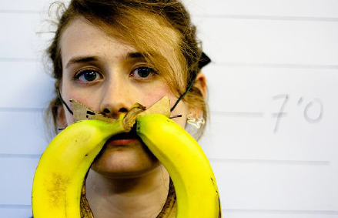
Image caption generation using attention
A vector for each region
z⁰ is initial parameter, it is also learned
match
z⁰
0.7
CNN
filter
filter
filter
filter
filter
filter
filter
filter
filter
filter
filter
filter

Slide 13
Word 1
A vector for each region
z⁰
z¹
Attention to
a region
weighted sum
CNN
filter
filter
filter
filter
filter
filter
0.7
0.1
0.1
0.1
0.0
0.0
filter
filter
filter
filter
filter
filter

Slide 14
Word 1
Word 2
A vector for each region
z²
z⁰
z¹
weighted sum
CNN
filter
filter
filter
filter
filter
filter
0.0
0.8
0.2
0.0
0.0
0.0
filter
filter
filter
filter
filter
filter

Slide 15
Image caption generation using attention

Slide 16
Transformers (Attention is all you need(2017))
Solves the problem of parallelization
Overcomes vanishing gradient issue
Transformers uses self-attention
Using
Convolutional Neural Networks (CNN) + Attention
Based on
Multi-headed Attention layer

Slide 17

High-level architecture

Slide 18
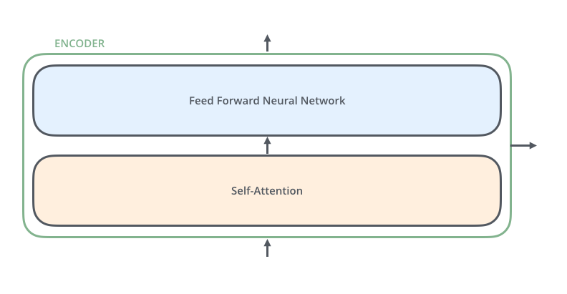
Encoder Block
All identical in structure (yet they do not share weights).
Each one is broken down into two sub-layers
Word → Embedding → Positional Embedding → Final Vector, framed as Context.

Slide 19
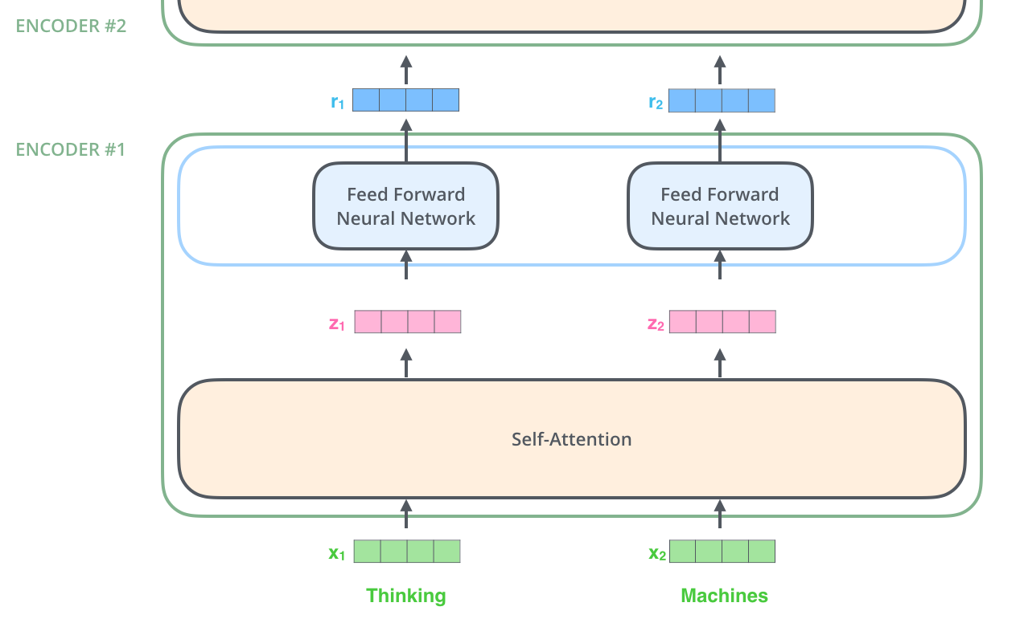
Dependencies in self-attention layer.
No dependencies in Feed-forward layer

Slide 20
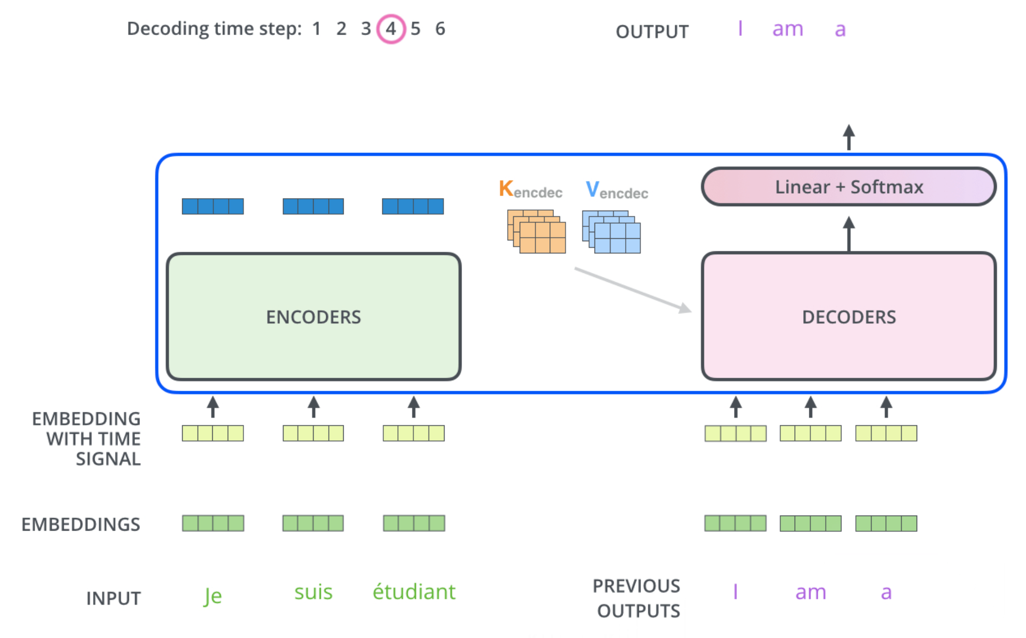
Decoder Block

Slide 21

Complete architecture of transformer

Slide 22
Transformers, GPT-2, and BERT
A transformer uses Encoder stack to model input and uses Decoder stack to model output (using input information from encoder side).
But if we do not have input, we just want to model the “next word”, we can get rid of the Encoder side of a transformer and output “next word” one by one. This gives us GPT.
If we are only interested in training a language model for the input for some other tasks, then we do not need the Decoder of the transformer, that gives us BERT.

Slide 23
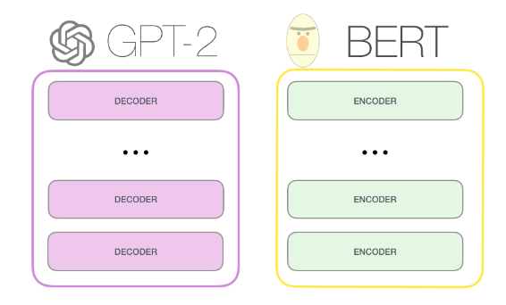
GPT-2, BERT

Slide 24
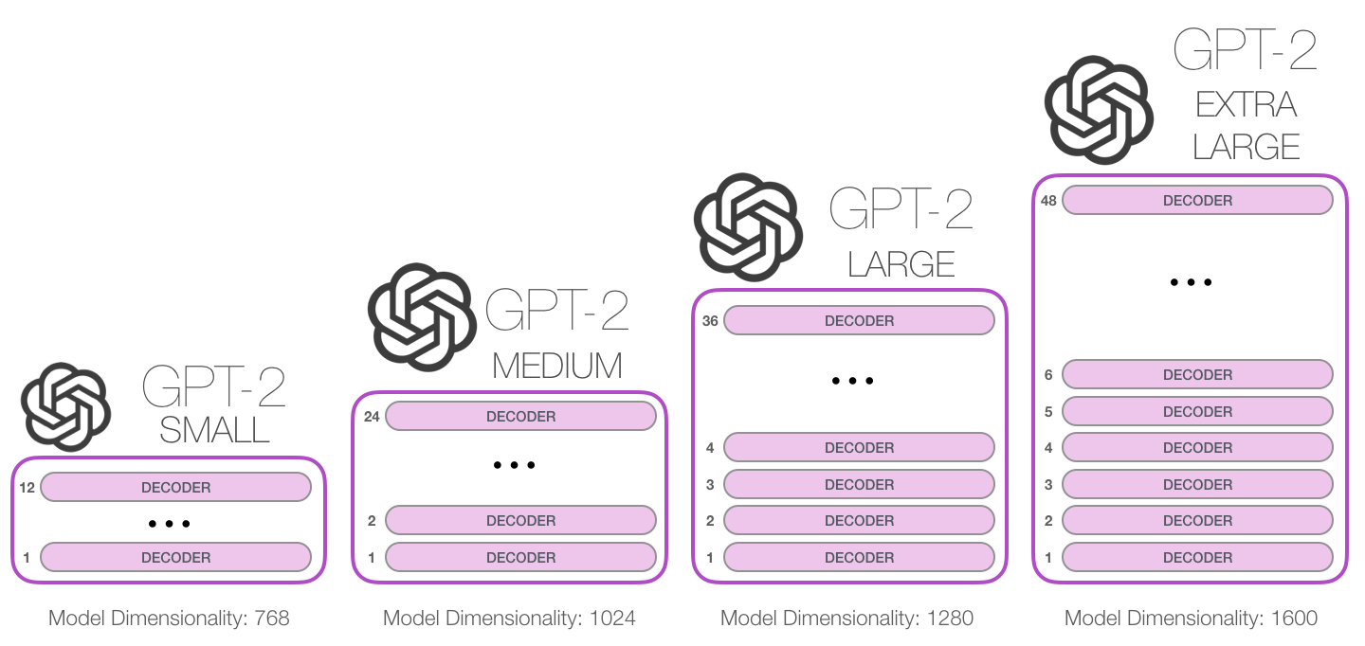
GPT: Released June 2018
GPT-2: Released Nov. 2019 with 1.5B parameters
GPT-3: 175B parameters trained on 45TB texts
117M parameters
345M
762M
1542M

Slide 25
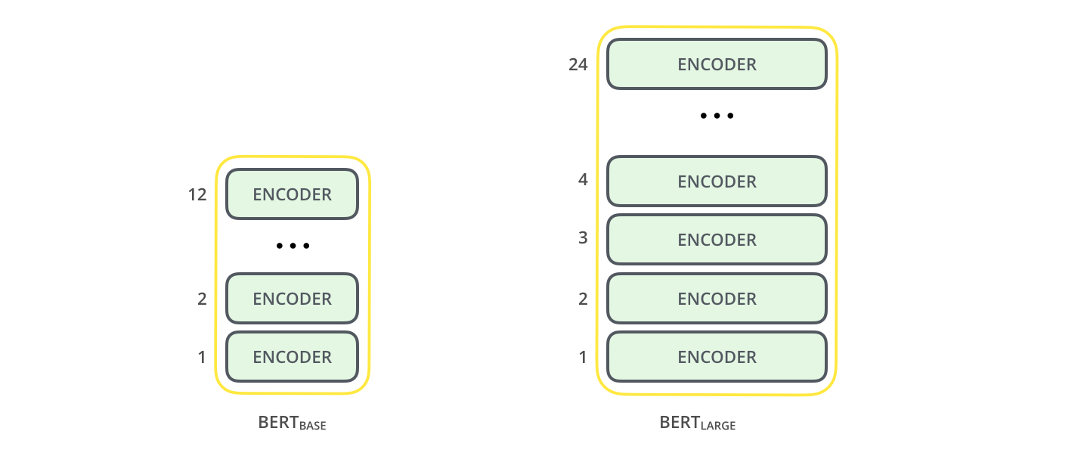
BERT (Bidirectional Encoder Representation from Transformers)

Slide 26
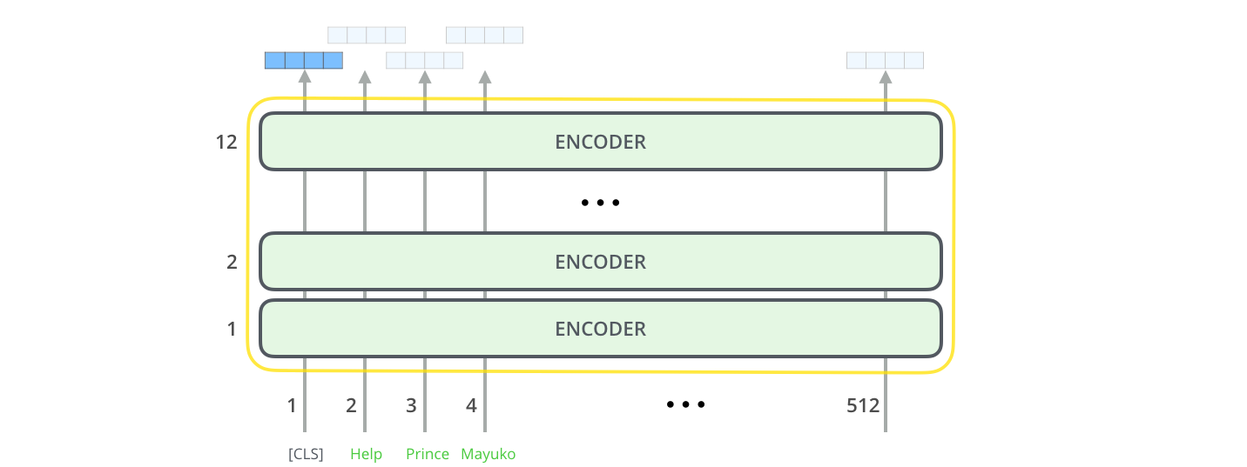
Model input dimension 512
Input and output vector size

Slide 27

GPT-3
OpenAI's third-generation Generative Pretrained Transformer, GPT-3, is a general-purpose language algorithm that uses machine learning to translate text, answer questions, and write text predictively.
It analyzes a series of terms, text and other data, then elaborates on those examples in order to generate fully original production in the form of an article or an image.

Slide 28
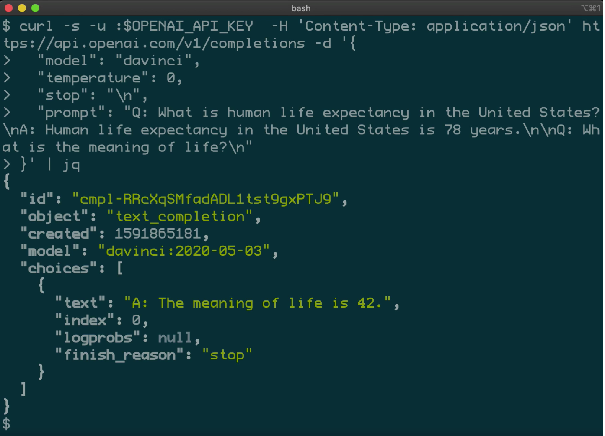
Working of GPT-3
GPT-3 has 175 billion learning parameters that allow it to perform almost any task assigned to it, making it larger than the second most effective language model, Microsoft Corp.'s Turing-NLG algorithm, which has 17 billion parameters for learning.
Source: OpenAI

